Slide 1



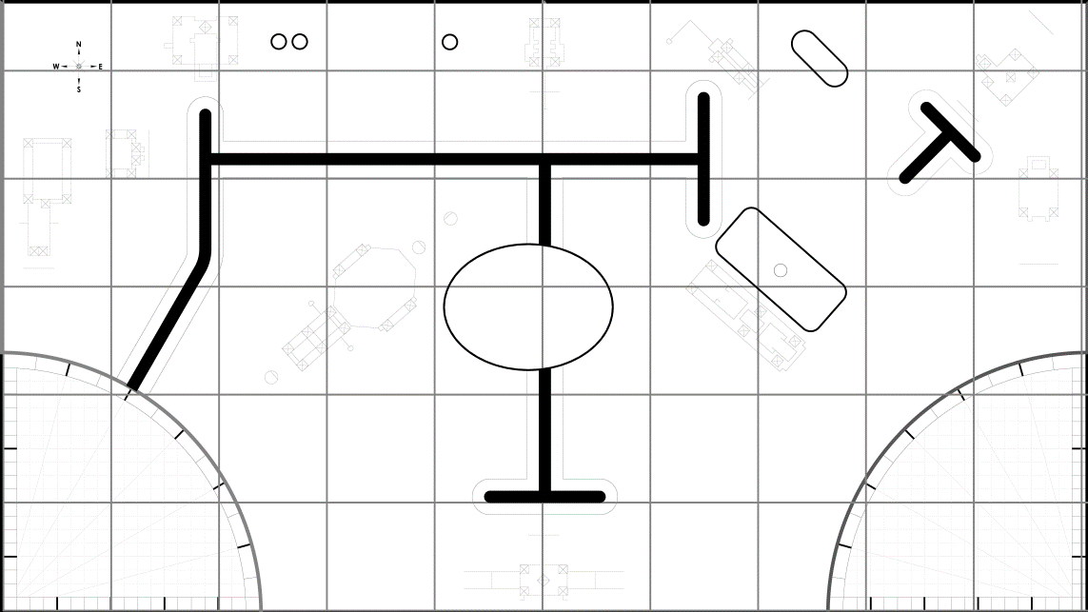

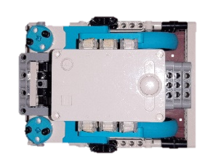
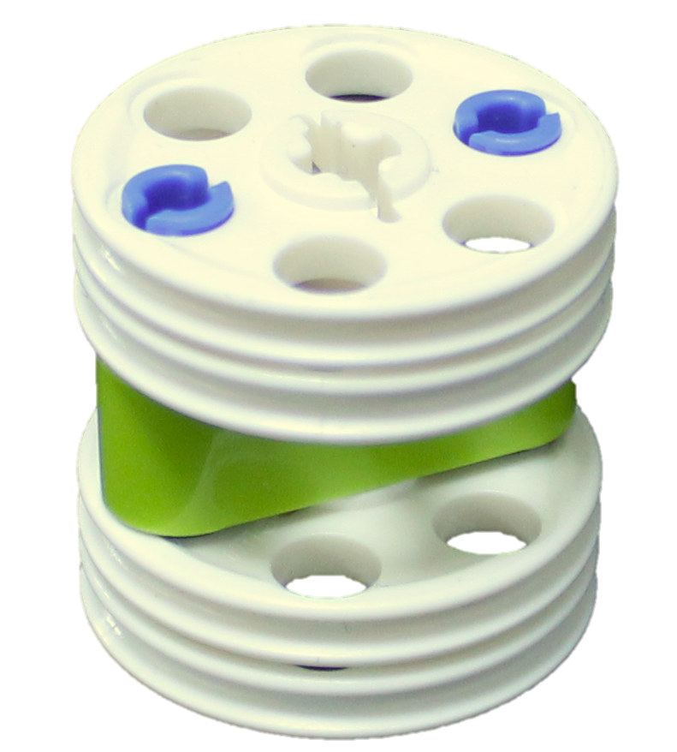
POINTS:
25
Run 1
01
02
03
04
05
06
07
08
09
10
11
12
13
14
15
MISSIONS:
1
2

Slide 2

POINTS:
95
Run 2
01
02
03
04
05
06
07
08
09
10
11
12
13
14
15
MISSIONS:
1
1
3

Slide 3
POINTS:
130
Run 3
01
02
03
04
05
06
07
08
09
10
11
12
13
14
15
MISSIONS:
1
1

Slide 4
POINTS:
160
Run 4
01
02
03
04
05
06
07
08
09
10
11
12
13
14
15
MISSIONS:
1

Slide 5
POINTS:
220
Run 5
01
02
03
04
05
06
07
08
09
10
11
12
13
14
15
MISSIONS:
3
5

Slide 6
POINTS:
270
Run 6
01
02
03
04
05
06
07
08
09
10
11
12
13
14
15
MISSIONS:
3
3

Slide 7
POINTS:
270
Run 7
01
02
03
04
05
06
07
08
09
10
11
12
13
14
15
MISSIONS:
3
3

Slide 8
POINTS:
400
Run 8
01
02
03
04
05
06
07
08
09
10
11
12
13
14
15
MISSIONS:

